Slide 1
Fisk-Vanderbilt Master’S to PhD Bridge Program
Co-Directors, Dr. Arnold Burger and Dr. Kelly Holley-Bockelmann
Executive Director, Dina Myers Stroud
Assistant Director, Lauren Campbell

Slide 2
What is the Bridge Program?
Started in 2004 with the mission to increase underrepresented minorities in STEM workforce and academe
Students from all over the county come to Fisk to do a fully funded master’s including courses and research at both institutions
Students then attempt to “bridge” to Vanderbilt or another PhD granting institution
Small gains in absolute numbers can have a big proportional impact on a national scale
Of the 24 PhDs awarded to African-Americans in Astronomy and Physics between 2013-2017 (APS), half of those students came through the Fisk-Vanderbilt Bridge

Slide 3
Our Students
Enrolled 153 Students
58% African-American
23% Hispanic /Latinx
3% Other Minority, including Native American, Native Hawaiian and Pacific Islander
16% White or other non-underrepresented minority
58% Female and 42% Male
Approximately 95% of students are from underrepresented or underserved groups such as low income, first generation, or physical or learning disabilities.

Slide 4
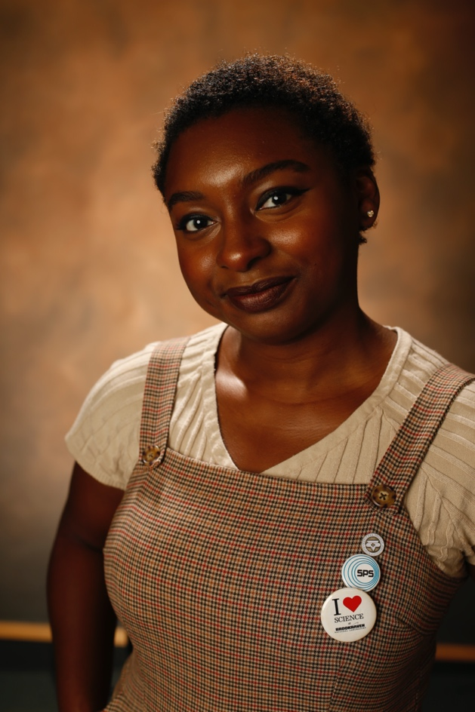
Program Outcomes
Awarded 79 Master’s degrees in Physics
30 PhDs in Physics, astronomy, or materials Science
90% of the students have earned or are making progress to the PhD
8 Year PhD Completion Rate of 84%
Without the use of GRE or GPA as metrics for selection

Slide 5
Application Review
Personal Statement
Communication Skills
Motivation for PhD
Long-terms Goals
Transcript
Background Courses
GPA Trajectory
Letters of Recommendation
Work Ethic
Persistence
Ownership
Scores are used to determine candidates to interview.
30 minutes (no camera) with a standard set of questions intended to probe understanding of research and non-cognitive attributes.
10-15% acceptance rate- No shortage of candidates

Slide 6
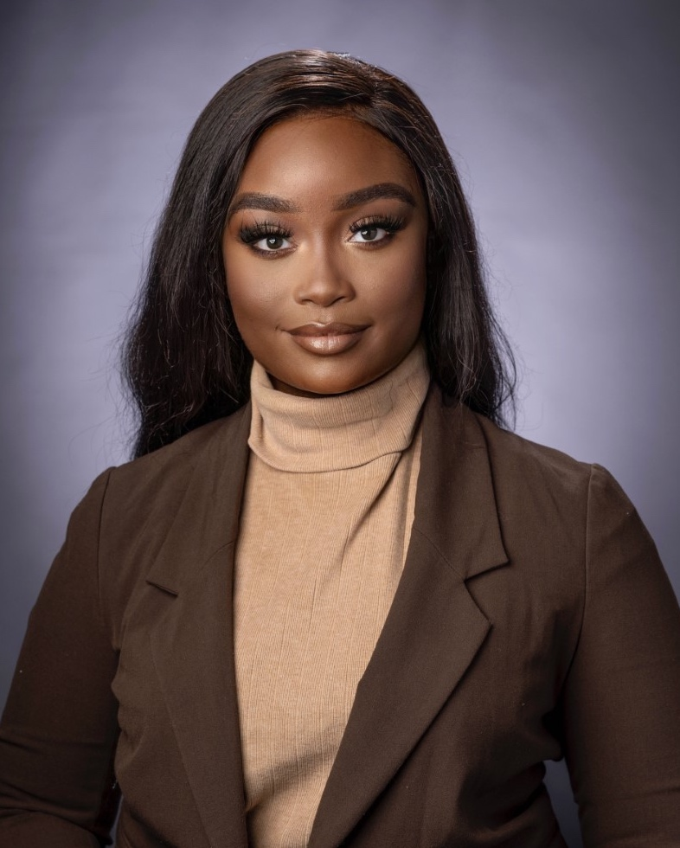
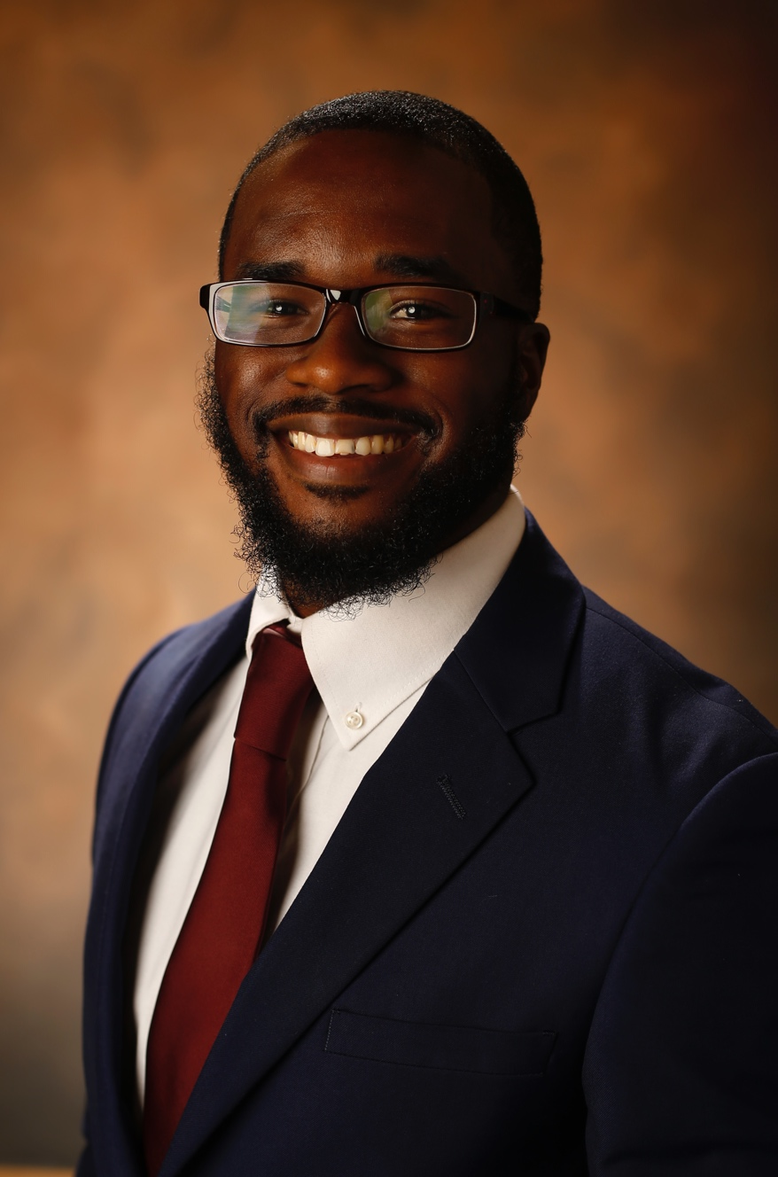
Mentoring
Peer Mentoring-
Cohort
Welcoming Committee
Post-docs and Alumni
Program Coordinator
Directors of Graduate Studies
Bridge Administrative Team and Steering Committee
Advisor
No one person meets all mentoring needs

Slide 7
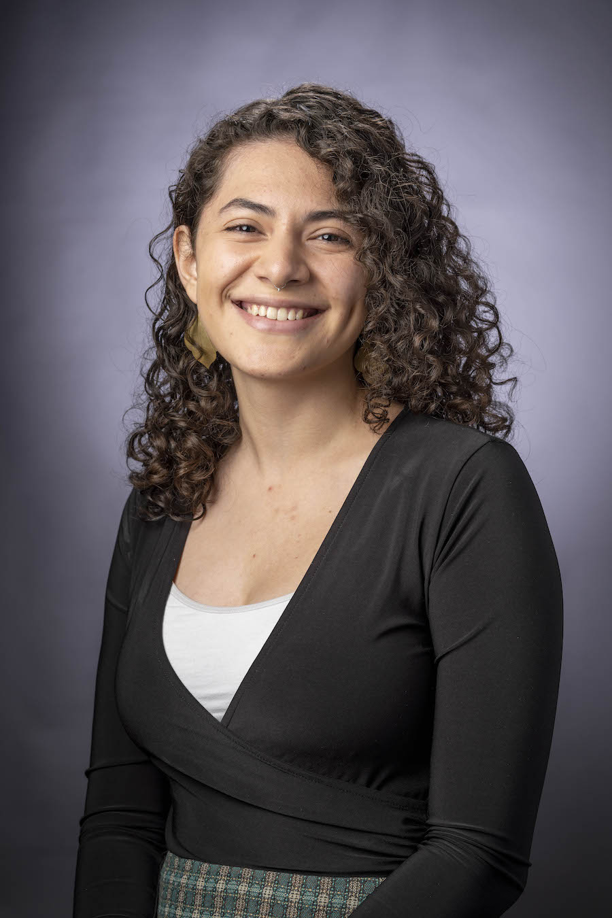
Community Building
Sense of Belonging- The Bridge Family
Solidification of the Cohort- Boot Camp
Professional Development Course and Evening Seminars
Independent Social Activities
Bridge Research Celebration Day
Recognition of Success

Slide 8
Recommendations
Holistic review Practice
Partner with Minority serving Institutions
Intentional Engagement
Mentor Training
Listen
Recognition of racism

