Slide 1
A Faculty-Centered Approach Towards Increasing Diversity in Physics
Quinton L. Williams, Ph.D.
Chair and Professor of Physics
Department of Physics and Astronomy
Howard University
September 21, 2020 – APS Webinar - Removing Barriers: Physics in HBCU, MSI, and PBI Communities

Slide 2
Doctorate recipients, by subfield of study, ethnicity, and race: 2018
African Americans earned only 0.65% of the Ph.D.s in physics that were awarded in 2018!
Source(s): National Center for Science and Engineering Statistics, Survey of Earned Doctorates

Slide 3
Although the overall growth of bachelor’s degrees awarded in physics has been phenomenal since 1995, the percent change for African Americans remained mostly flat and has only shown a relatively small upward trend since about 2014.
Bertschinger, PERC2020, Data from NCES/IPEDS.

Slide 4
Out of 754 physics departments with 194 awarding Ph.D.s in physics, only 13 African Americans earned Ph.D. degrees in physics in 2018. One can infer that the underrepresentation of African Americans in physics is systemic.

Slide 5
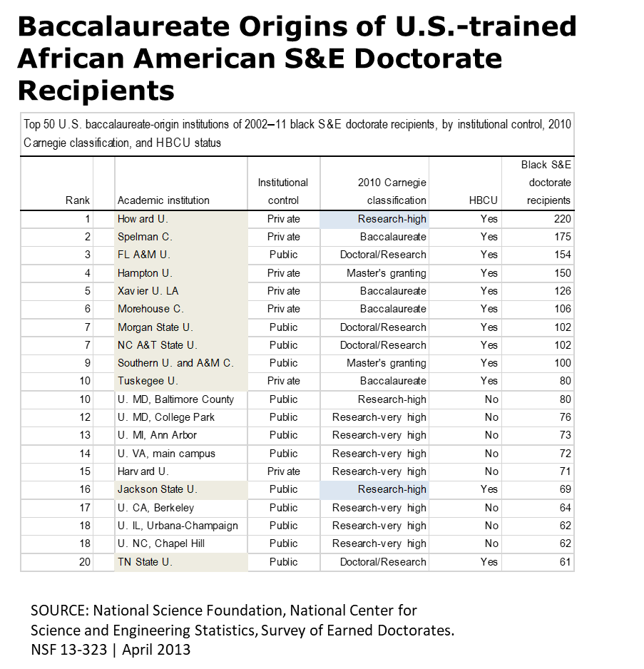
African American population in US: ~12.7%.
Where are they?

Slide 6
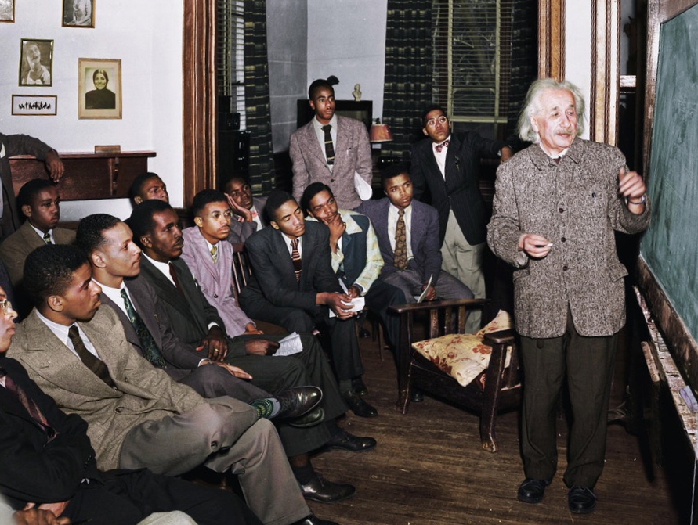
Albert Einstein knew this when he lectured at Lincoln Univ. in 1946!

Slide 7
What can an individual faculty member do?
* Attitude Change – Stop being indifferent. It’s not someone else’s problem to fix. This is a huge problem in the physics community of which you are a part. Therefore, it is also part of YOUR professional responsibility to help resolve the issue. Plus, you will increase your cultural awareness and broaden your network for innovation and discovery.
* Active recruitment – Take an active approach towards incorporating African American graduate students into your own research group. Intentionally use your department’s REU or summer internship programs to recruit and serve as pathways for African American students to enter into your Ph.D. pipeline. Consider the whole student when evaluating candidates.
* Partner with an HBCU, MSI or PBI – You now have a good idea of where the majority of African American students are located who go on to pursue doctorates in S&E. Develop an informal partnership or a formal collaboration with an HBCU, MSI or PBI to catalyze and lead change in your department.
* How to begin? – The journey begins with YOU taking the first step. If you do not have a colleague who can help you connect with HBCUs, MSIs, and PBIs, please contact the National Society of Black Physicists (NSBP). NSBP can readily connect you with a physics program at an HBCU, MSI, or PBI near you.

Slide 8
THANK YOU!

