Slide 1

TEAM-UP Report
From Passion to Action: Levers & Tools for Making Physics Inclusive & Equitable
Arlene Modeste Knowles
AIP TEAMUP Project Manager
aknowles@aip.org
6/24/2020

Slide 2
TEAM-UP Charge from the AIP Board
Examine and assess the reasons for the persistent underrepresentation of African Americans in physics and astronomy at the bachelor’s level; and
Produce a report with evidence-based recommendations for AIP Member Societies, physics and astronomy departments, and other stakeholders to increase the number and percentage of African American students obtaining bachelor’s degrees in physics and astronomy

Slide 3
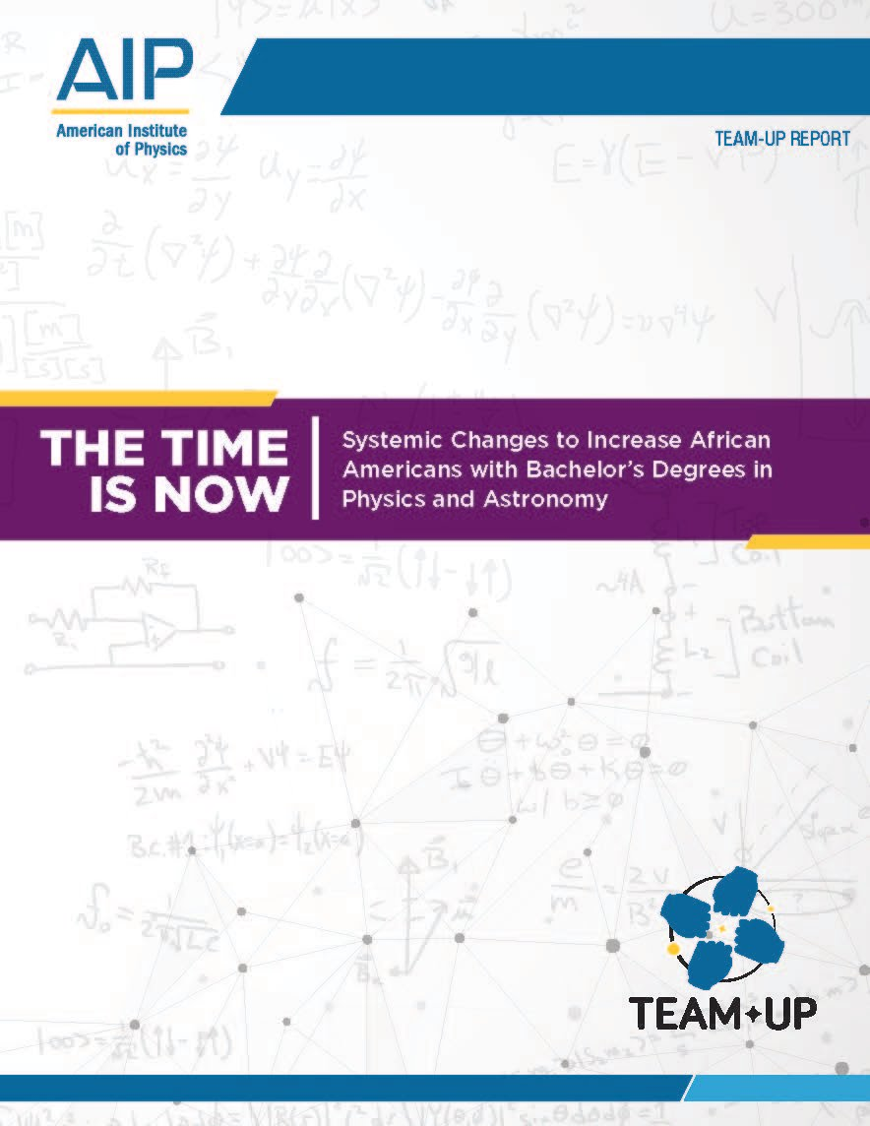
AIP TEAM-UP Report
The Time Is Now: Systemic Changes to Increase African Americans with Bachelor’s Degrees in Physics and Astronomy
aip.org/teamup

Slide 4
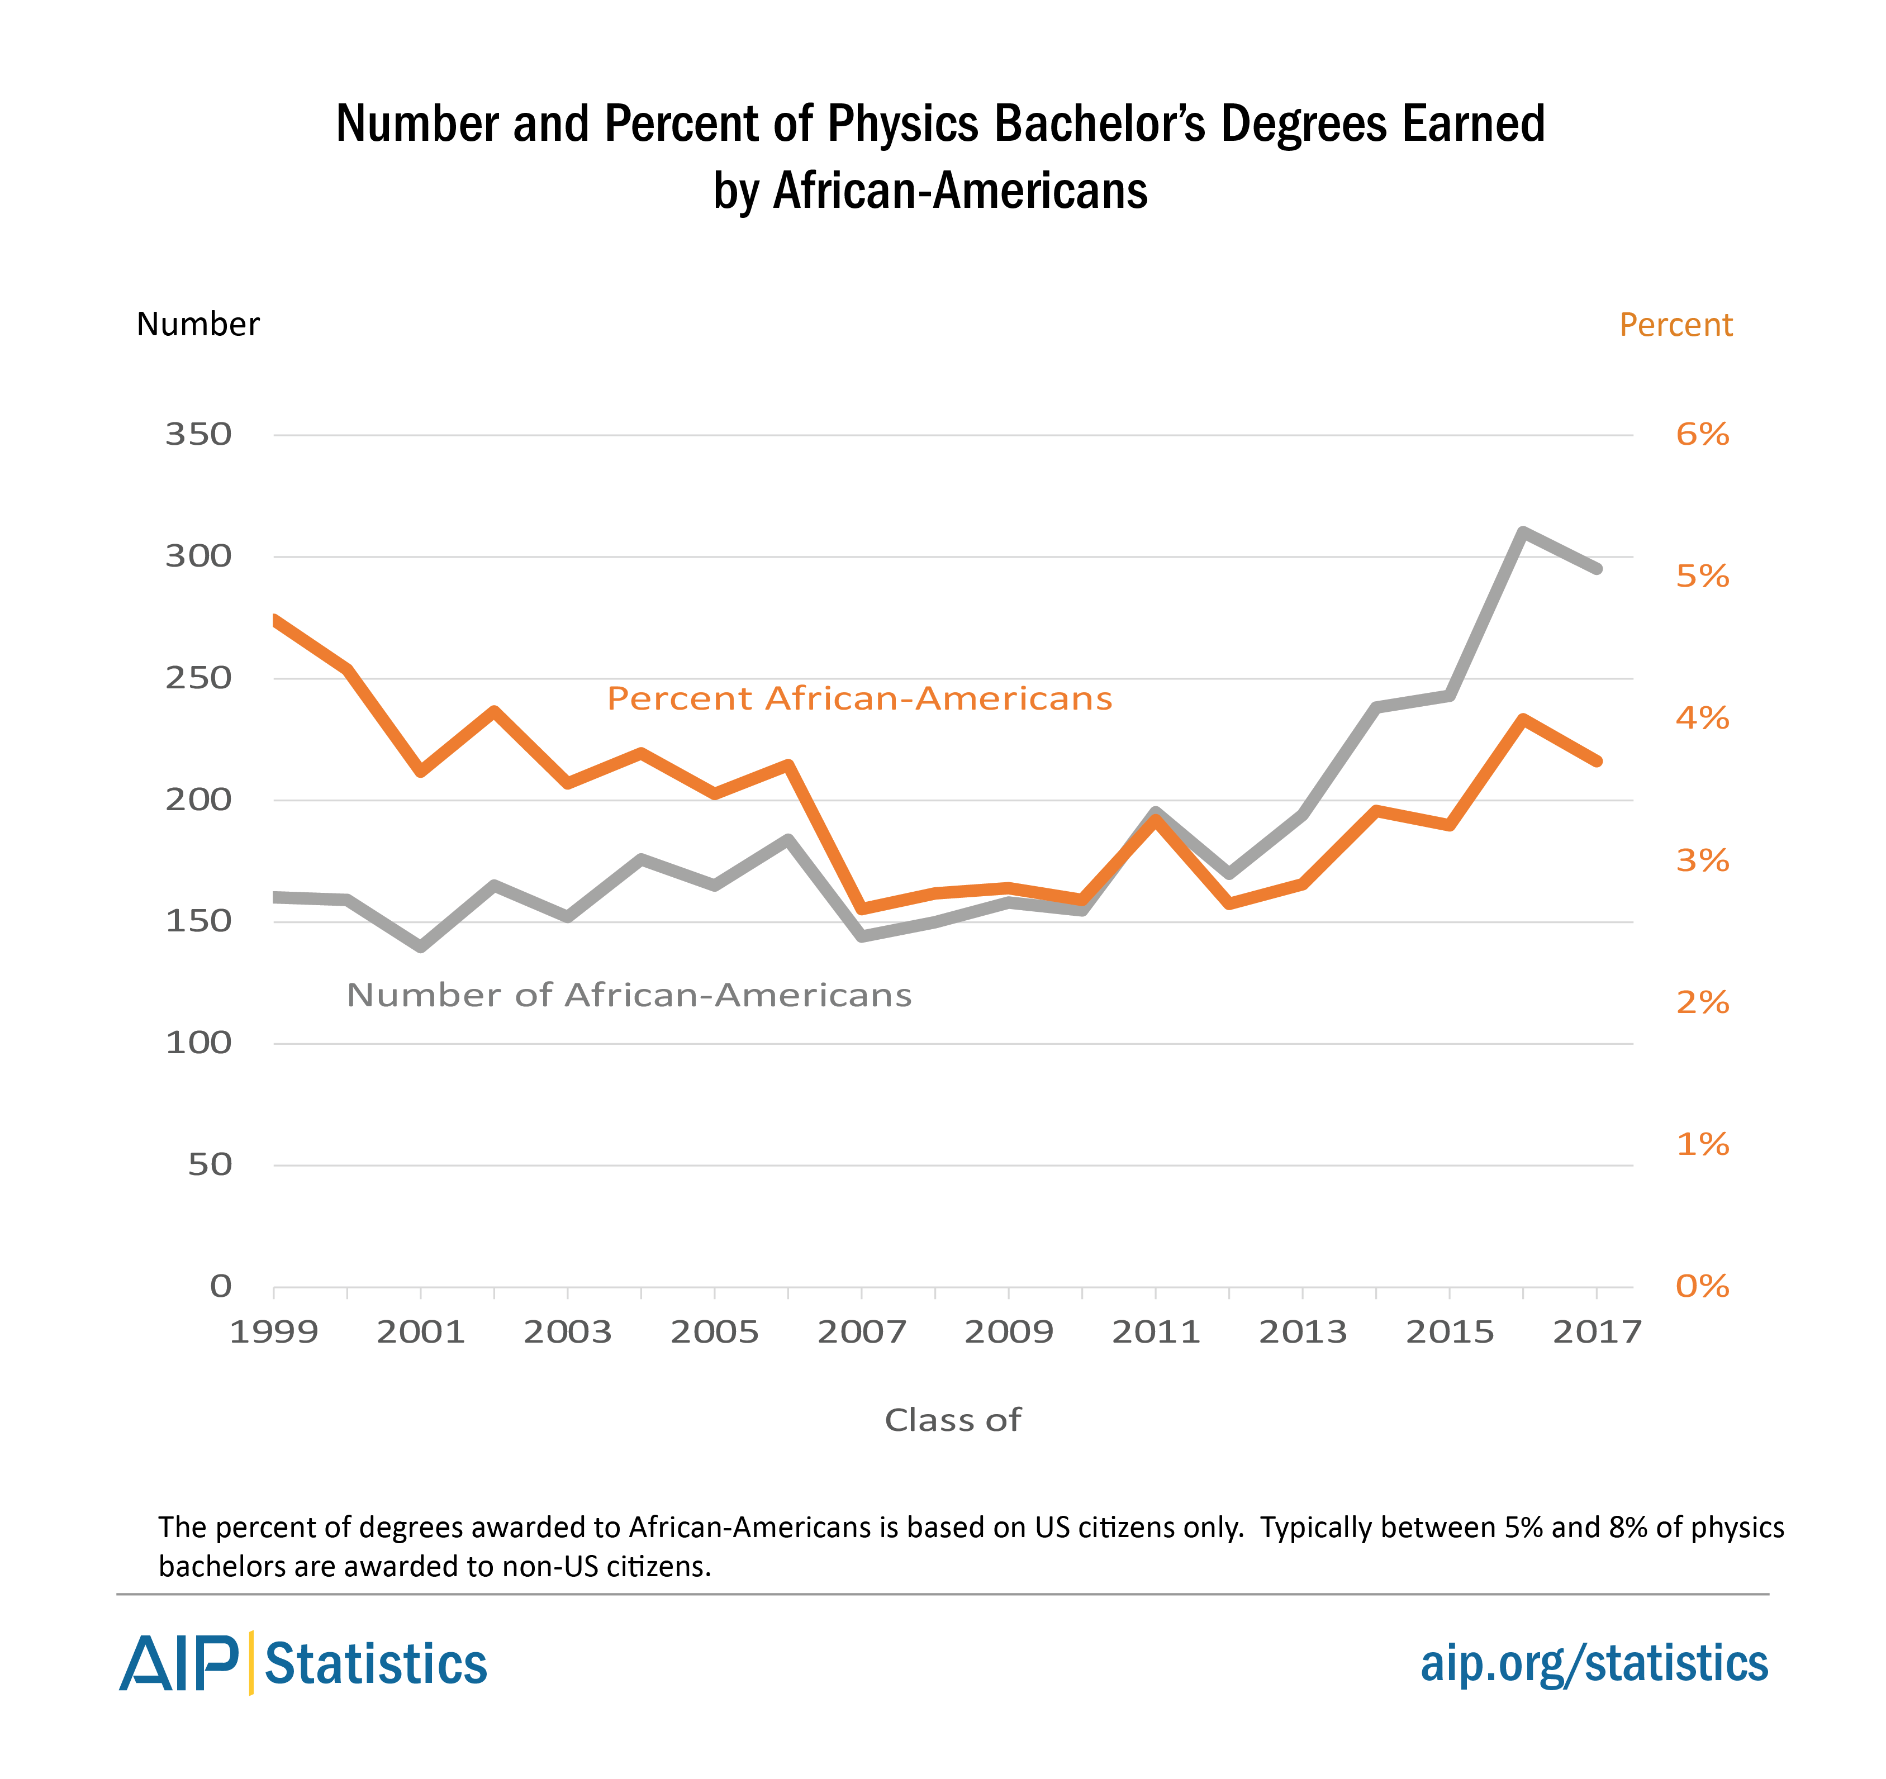
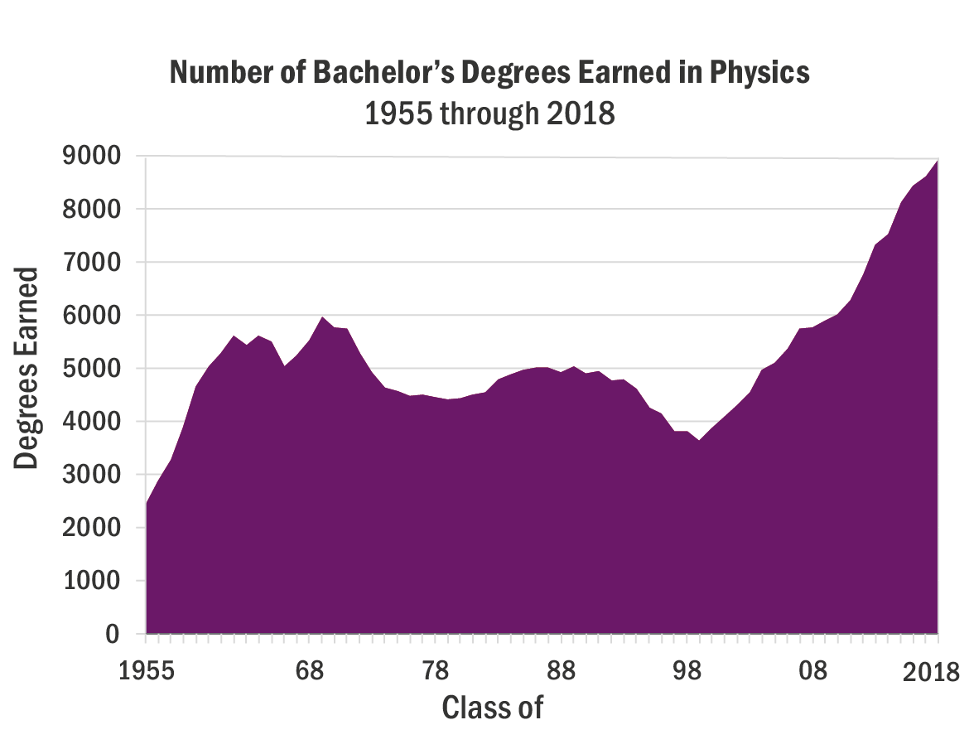
Physics Bachelor’s Degrees Earned

Slide 5
Conclusions
“African American students have the same drive, motivation, intellect, and capability to obtain physics and astronomy degrees as students of other races and ethnicities.
The persistent underrepresentation of African Americans in physics and astronomy is due to the lack of a supportive environment for these students in many departments, and to the enormous financial challenges facing them and the programs that have consistently demonstrated the best practices in supporting their success. Solving these problems requires addressing systemic and cultural issues and creating a large-scale change management framework.”

Slide 6
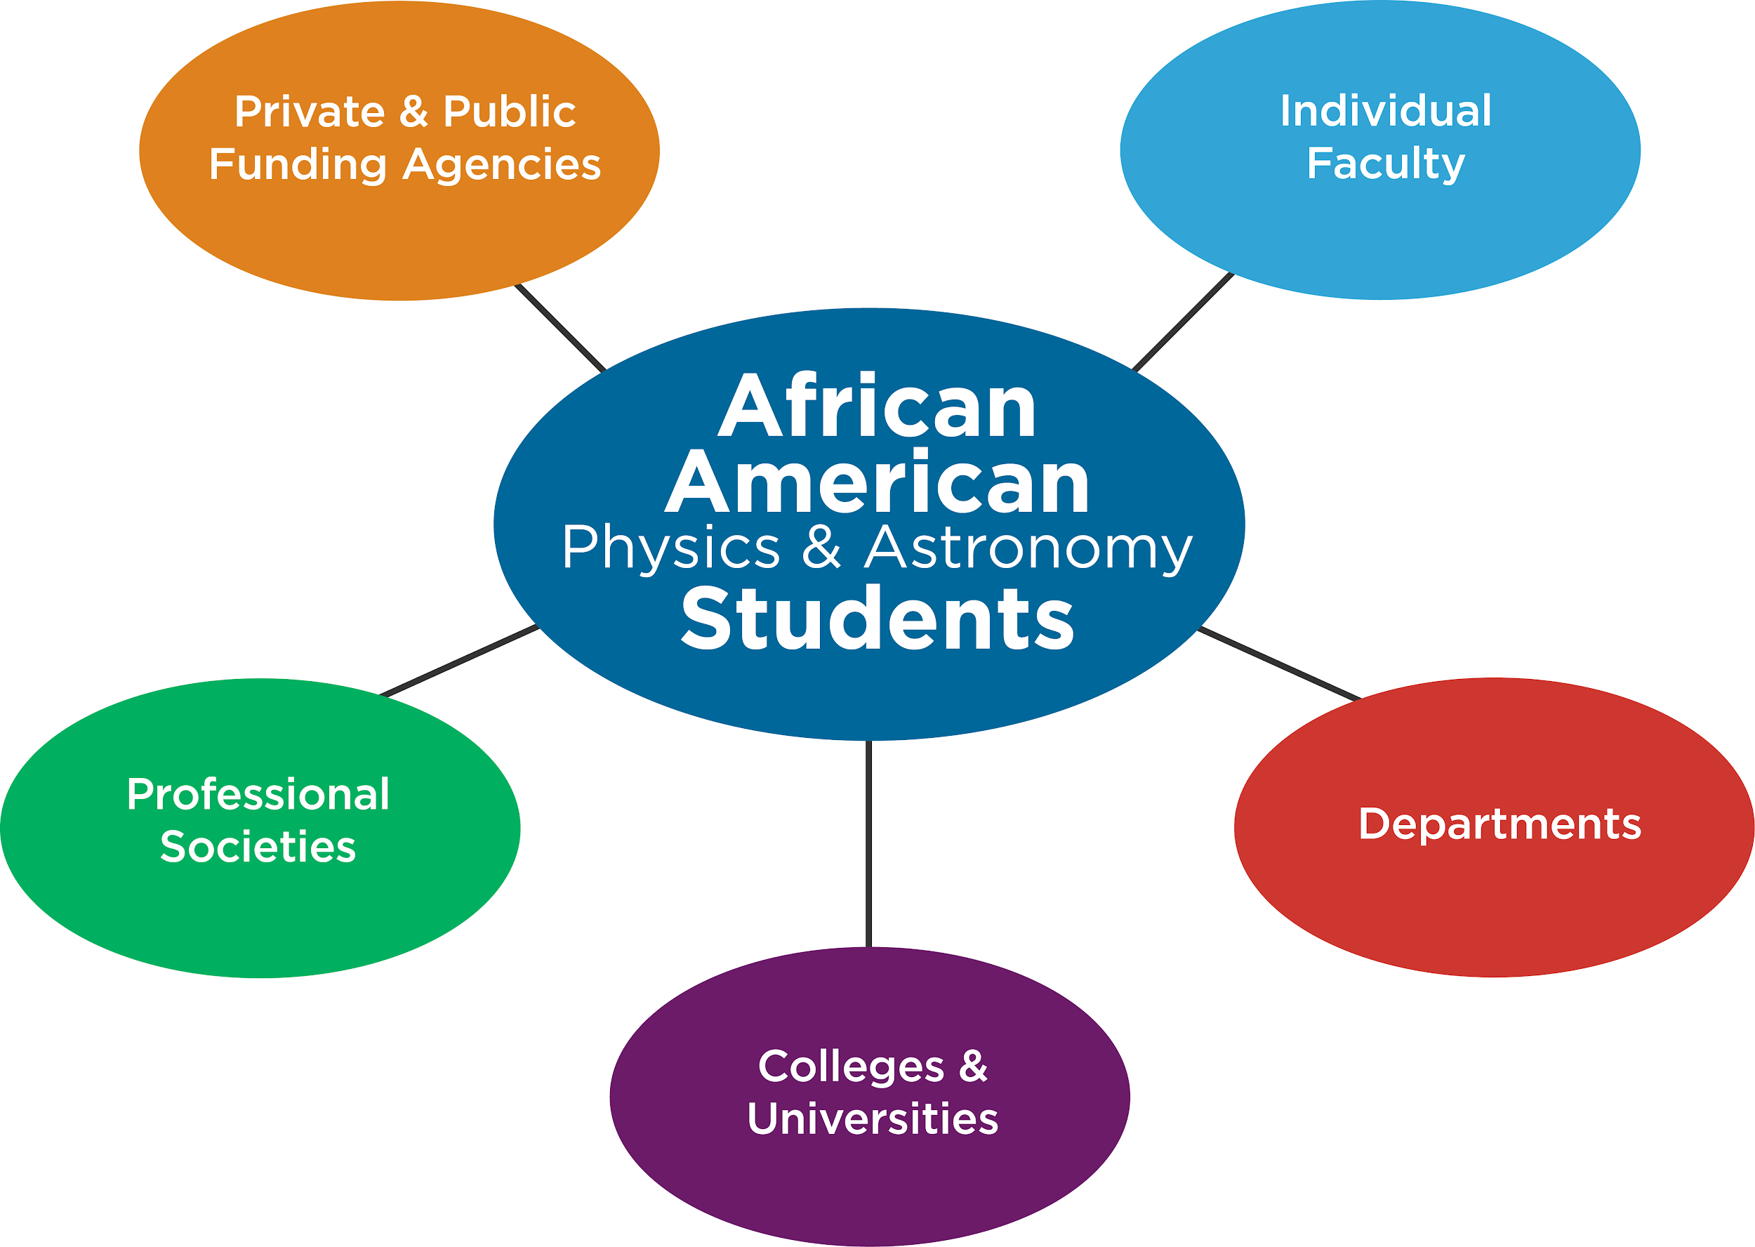
Community-wide efforts

Slide 7
Our bottom-line goal: 500 in 10
Double the number of physics & astronomy bachelor’s degrees earned by African Americans in a decade.
~500 African American bachelor’s degrees in physics per year by 2030.

Slide 8
Recent Pivotal Events
COVID-19 Pandemic
Racial violence
Protests for justice around the world
#ShutdownSTEM #Strike4BlackLives – June 10th
The Time is Now

Slide 9
Key Features of the TEAM-UP Report
Centers African American Student Experiences
Social Science Research
20 Findings and 25 Evidence-Based Recommendations
Focuses on Systemic & Culture Change
Provides a framework and a roadmap for departments and the community to address the issues hindering the success of African Americans earning bachelor’s degrees in physics and astronomy.

Slide 10
AIP TEAM-UP Report
The Time Is Now: Systemic Changes to Increase African Americans with Bachelor’s Degrees in Physics and Astronomy
aip.org/teamup

